Slide 1


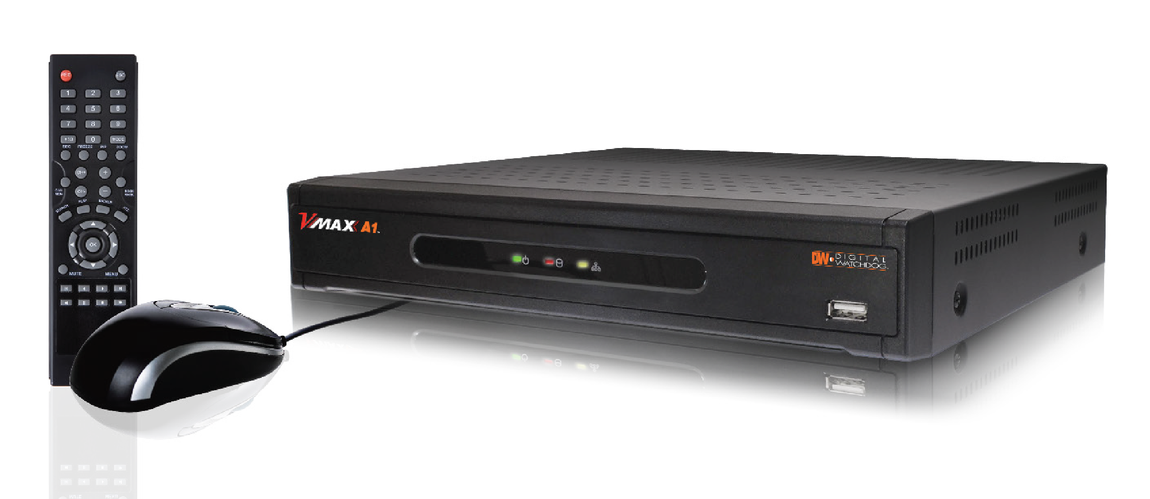
All-in-One Analog, AHD and TVI DVR
Product Overview
Presenter’s Name
Title | email@digital-watchdog.com
Rev : 04/15

Slide 2
What is the VMAX960H CORE™ Solution?
All-in-One Analog, AHD and TVI DVR
Real-time 960H, AHD and TVI Resolution Embedded Recording Solution Powered by the VMAX™ User Experience

Slide 3
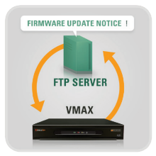


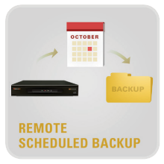
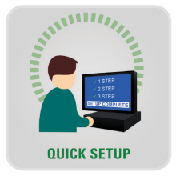
What is the VMAX960H CORE™ Solution?
All-in-One Analog, AHD and TVI DVR
The VMAX A1™ is a digital video recorder that offers real-time HD monitoring and recording up to 480fps at 960H and 720p and 240fps at 1080p (1920X1080) resolution. The VMAX A1 supports analog signals up to 960H, TVI and Analog High Definition (AHD) signals, leveraging the robustness of analog signal infrastructure for a seamless upgrade to the detail and clarity of 1080p high definition resolution. The A1™ is available in 4-, 8- and 16- channel configurations, is available with up to 12 Terabytes of internal storage and is backed by Digital Watchdog’s unbeatable 5 year limited warranty.

Slide 4
VMAX A1™ Product Comparison
 | DW-VAONE4 | DW-VAONE8 | DW-VAONE16
Video Input | 4ch BNC | 8ch BNC | 16ch BNC
Recording Resolutions | 960H and Below Analog and 1080p and 720p AHD and TVI Resolutions
HDD Interface | 1x HDD | 1x HDD | 2X HDD
Max Internal Storage | 1~6TB | 1~6TB | 2~12TB
Video Outputs | HD Output | HD Output, VGA | HD Output, VGA
Recording Resolution | 120fps in all Resolutions | 240fps in all Resolutions | 480fps in all Resolutions
Playback Resolution | 120fps in all Resolutions | 240fps in all Resolutions | 480fps in all Resolutions
RS485 Interface | 1x RS485 | 1x RS485 | 2x RS485
Alarm Input/ Sensor Output | 4 In / 1 Out | 4 In / 1 Out | 4 In / 1 Out
Audio In/ Out | 1 In / 1 Out | 1 In / 1 Out | 4 In / 1 Out
Looping Output | --- | --- | Supported
Playback Rate | Up to 30fps per Channel in Single-Channel View Mode Up to 15fps per Channel in Multi-Channel View Mode

Slide 5
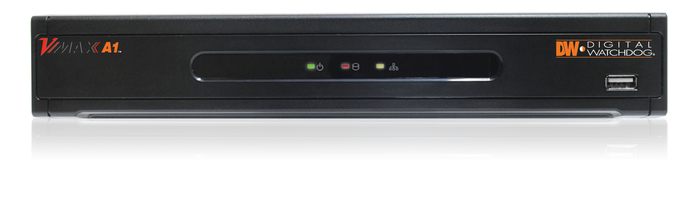

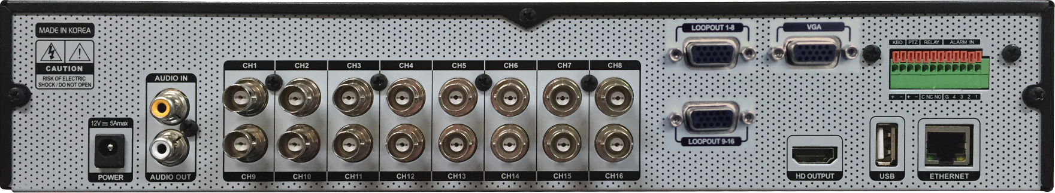
Hardware Overview – VMAX960H CORE™
Status Notification
Front Panel USB Interface
Audio In and Out
Looping Output
Analog, AHD and TVI Video Input

Slide 6
DVR Features (1 of 3)
Features:
Compatible with all 960H and below resolution Analog Cameras, AHD and TVI HD Formats (1080p via Coax) Resolutions
Pivot™ Central Management Software, Up to 128CH
Mobile Application for iPhone, iPad, iPod, Android Smart Phones and Tablets
MAC Compatible Remote ACS Software
Intuitive Graphical User Interface (GUI)
OSD and PTZ Control via Coax (UTC)
HDD Calculation and Auto Recording Configuration

Slide 7
DVR Features (2 of 3)
Features:
Event Notifications via Email, Text and Pivot™ CMS
Advanced H.264 Embedded DVR
Multiplex - Live, Playback, Recording, Backup, Network, Configuration
4-Channel: 60fps Recording in 1080p AHD or TVI Resolution, 120fps Recording 1080p AHD or TVI Resolution
8-Channel: 240fps Recording in 1080p AHD or TVI Resolution, 120fps Recording in all Analog Resolutions up to 960H and 720p
16-Channel: 240fps Recording in all Analog Resolutions up to 960H and 720p, 480fps Recording in all Analog Resolutions up to 960H and 720p

Slide 8
DVR Features (3 of 3)
Features:
1 Audio Input, 1 Audio Output
4 Sensor Input, 1 Relay Output
16-Channel Looping Output (DW-VLOOP Module Not Included) (16ch models only)
Simple & Free DDNS Service
Easy Web-Based Client with Multi-User Access
Help Menu on Major Functions
Auto & Manual Firmware Upgrade Available
5 Year Limited Warranty

Slide 9
AHD, TVI and 960H Signal Support
The VMAX A1 is the most simple way to upgrade an existing analog solution. With support for all 960H and below resolution Analog Cameras, AHD and TVI HD Formats (1080p via Coax) Resolutions, the DVR can be integrated into an existing application without the need to update the cameras at the same time. This allows for optimal financial flexibility and ROI, with individual components of an entire solutions updated separately.

Slide 10
PTZ and OSD Control via Coax (UTC)
UTC (Up The Coax) allows a user to access the camera's OSD (On Screen Display) through a coaxial connection, eliminating the need for an additional RS485 cable to reach the menu.

Slide 11
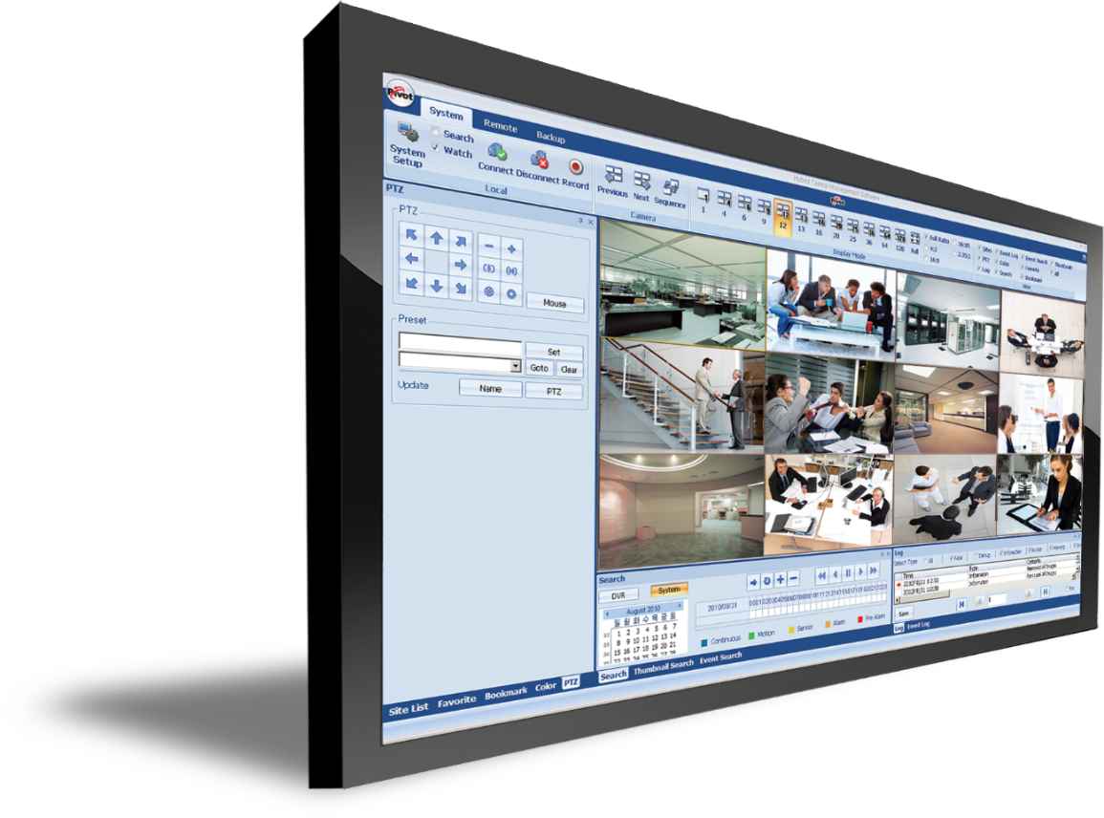

Pivot™ Central Management Software, Up to 128CH
Pivot™ is a powerful and flexible remote monitoring software, available free with any
Digital Watchdog® analog recording solution. Pivot™ CMS manages up to 128 sites and includes features such as Remote DVR configuration, Event Search, and Preview Search, which enables the user to control, configure, and monitor up to 128 channels.

Slide 12

Event Notifications via E-mail, CMS Software and SMS
The DVRs support event notifications for a variety of recording and system events. The notifications can be set to multiple e-mail accounts with attached screen shots, as a short text message, or event log to Pivot™ Remote Monitoring Software.

Slide 13
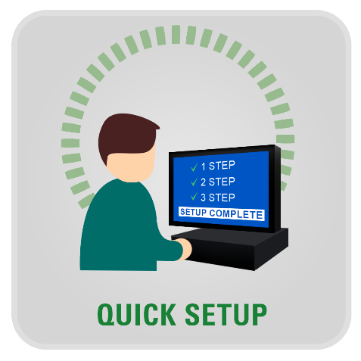
DVR Quick Setup Wizard
Quickly and Easily setup the DVR’s Date/Time, Recording, Network and Quick setup. When the DVR boots up, the Quick Startup Wizard will appear automatically.
It can be disabled by a setting in the main menu.

Slide 14

Help Menu on Major Functions
DW’s Help Menu will help you to setup several important settings without the user manual. Just click the yellow Help button. DW is the first to use interactive help menus.

Slide 15
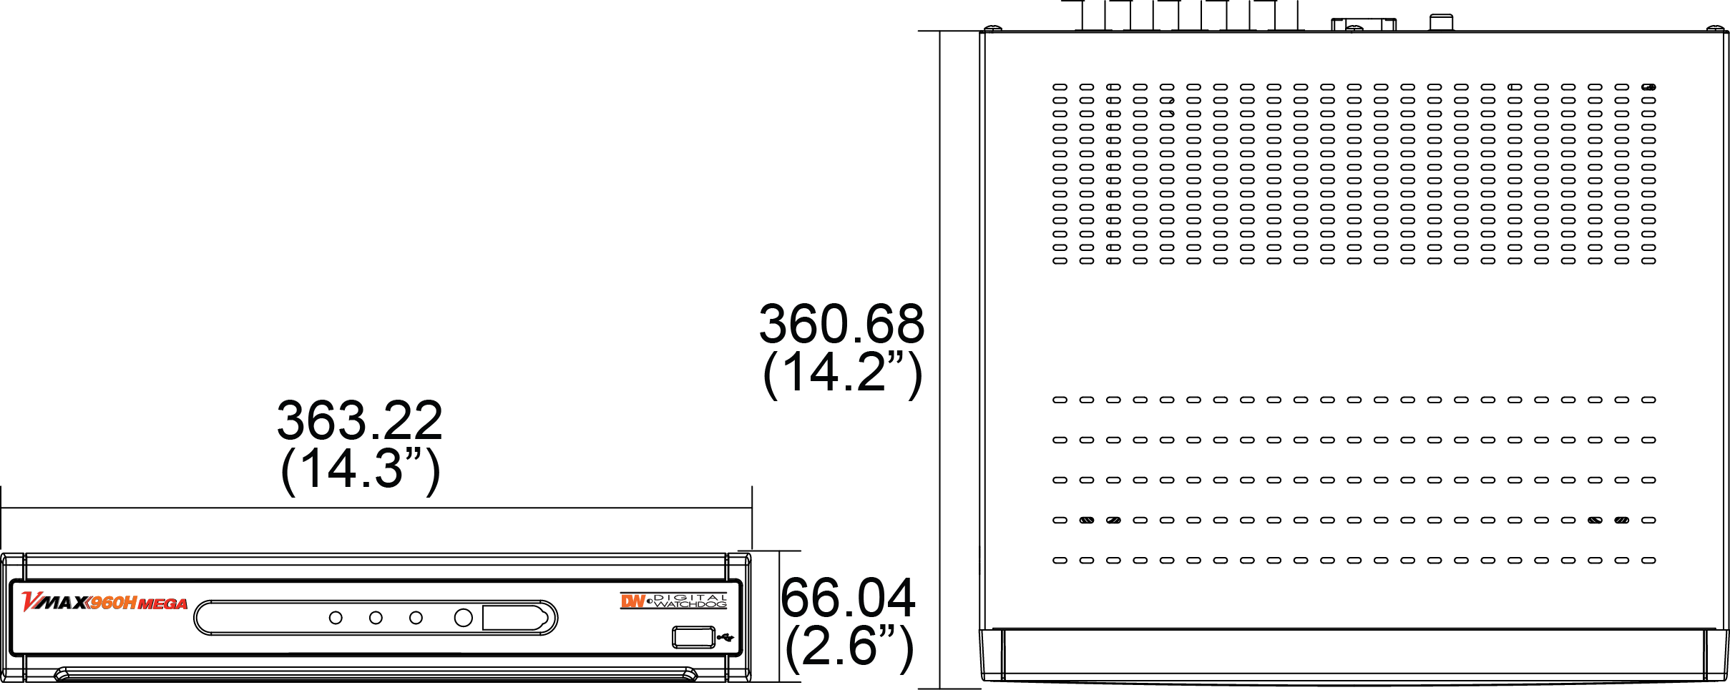
Product Dimensions

Slide 16
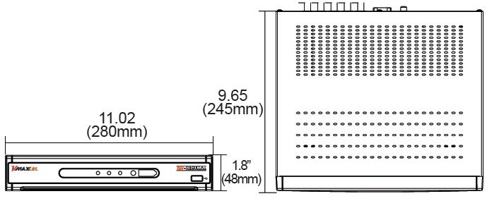
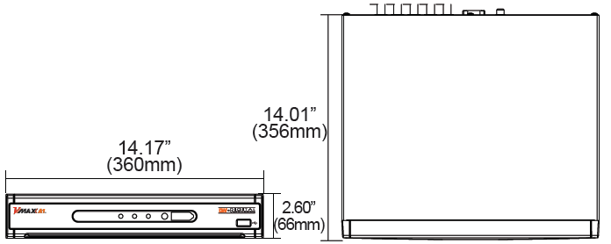
Purchasing Options
VMAX A1™ 4- and 8- Channel Model:
VMAX A1™ 16 Channel Model:

Slide 17
Purchasing Options
VMAX A1™ 4 Channel Model:
  DW-VAONE 41T
  DW-VAONE 42T
  DW-VAONE 43T
  DW-VAONE 44T
VMAX A1™ 16 Channel Model:
  DW-VAONEC 162T
  DW-VAONE 163T
  DW-VAONE 164T
  DW-VAONE 166T
  DW-VAONE 168T
  DW-VAONE 1612T
VMAX A1™ 8 Channel Model:
  DW-VAONE 81T
  DW-VAONE 82T
  DW-VAONE 83T
  DW-VAONE 84T

Slide 18
Questions?
Thank you!

